Slide 1

Customer Retention
(Case Study)

Slide 2
Index
Introduction
Understanding Of Problem Statement
EDA
Visualizations
Assumptions
Analysis
Conclusion
Links For Reference

Slide 3
Introduction
Customer retention is one of the main relationship marketing objectives. Currently the perception and application of customer retention is significantly valuable for companies & for that different strategies are used like Go all in on Email Marketing, Nurture your Customers on Social Media Channels, Offer Personalized Customer Experience, Have SOPs in Place to Improve Customer Satisfaction, Create Valuable Content to Engage Customers, Offer a Customer Loyalty Program, Leverage User-Generated Content, Showcase your Brand’s Story and Values.
Customer satisfaction has emerged as one of the most important factors that guarantee the success of online store; it has been posited as a key stimulant of purchase, repurchase intentions and customer loyalty. A comprehensive review of the literature, theories and models have been carried out to propose the models for customer activation and customer retention.
Five major factors that contributed to the success of an e-commerce store have been identified as: service quality, system quality, information quality, trust and net benefit. The research furthermore investigated the factors that influence the online customers repeat purchase intention. The combination of both utilitarian value and hedonistic values are needed to affect the repeat purchase intention (loyalty) positively.

Slide 4
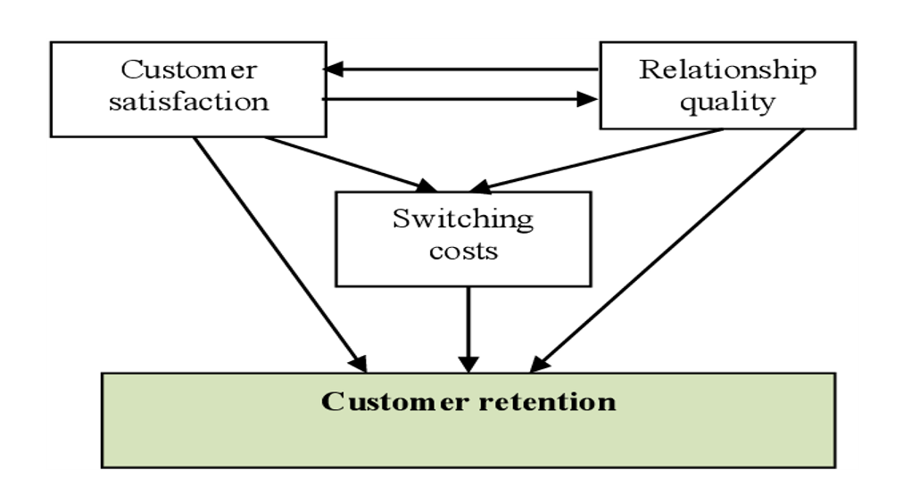

Slide 5
UNDERSTANDING OF PROBLEM STATEMENT
*** E-retail factors for customer activation and retention: A case study from Indian e-commerce customers
The problem statement contains the survey of different question answers from customers about their satisfaction levels and experience with different websites/applications & overall purchase.
The main purpose of this is to know about the Customer retention/Repeat purchase intention.
The combination of utilitarian value and hedonistic values are needed to affect the repeat purchase intention (loyalty) positively. The data is collected from the Indian online shoppers. Results indicate the e-retail success factors, which are very much critical for customer satisfaction.
The total number of columns are 71 in the given dataset with 269 rows.
We need to do the research & find out whether the e-commerce businesses are fulfilling the needs of customers and maintaining/creating the trust.

Slide 6
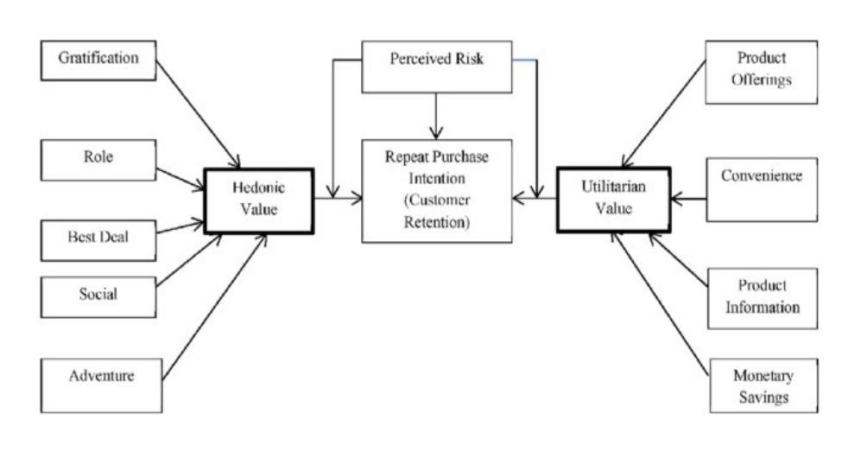

Slide 7
EDA
Exploratory Data Analysis or EDA is used to take insights from the data. Data Scientists and Analysts try to find different patterns, relations, and anomalies in the data using some statistical graphs and other visualization techniques.
We have done the following analysis of the dataset :-
1. Import libraries and load dataset
2. Converted the Strings into Integers for further process
3. Checked for missing values
4. Checked the correlation among all the columns – statistical

Slide 8
VISUALIZATIONS​
Data visualization is defined as a Graphical Representation that contains the information and the data.
Following are the visualizations I made :
1. Correlation Matrix :
I used Heatmap for showing the Correlation between the variables.
The result of the Correlation Matrix is on next slide. As it's very huge and can't see the numbers and data easily I am sharing the link of GitHub where I have stored the result of this.

Slide 9
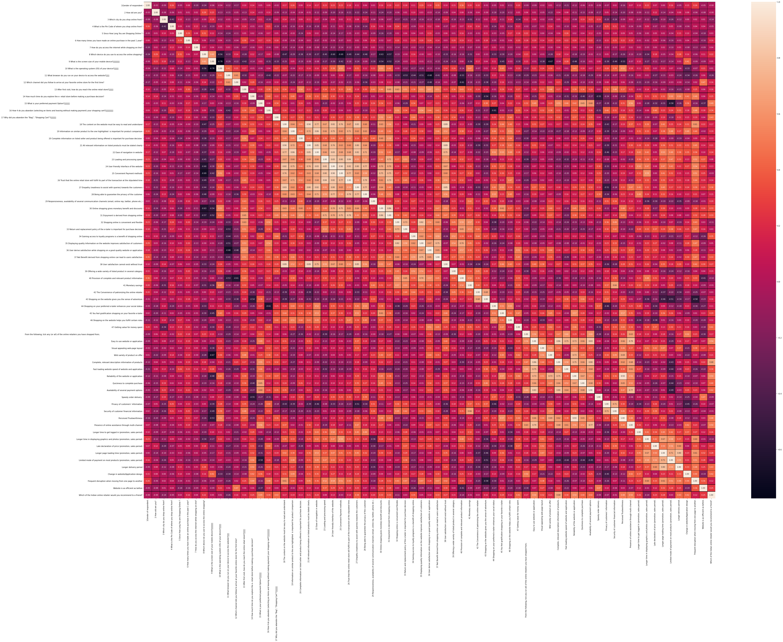

Slide 10
2. Histogram of all dataset :
I plot Histogram for visualizing the data individually.
Again as data has many columns so I am sharing the GitHub link of the result for clarity in the links slide.

Slide 11
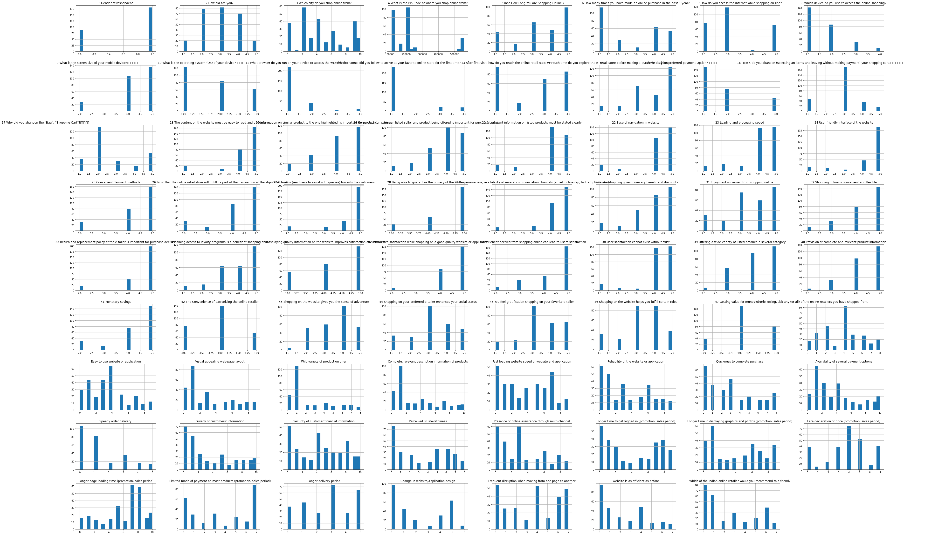

Slide 12
ASSUMPTIONS​
As per my knowledge & understanding :
I found that all the features or variables are important for analysis so I have not removed anything.
There were no null values found which was good.
There were some columns with strings so I encoded them with label encoder for balance the data type for further process.
From the output of correlation matrix, we can see that it is symmetrical i.e. the bottom left is same as the top right. It is also observed that most of the variables are positively correlated with each other.
The Histogram shows that each variable distributed differently and as we can see the data has categorical values, histogram is better visualization graph to show the distribution.

Slide 13
Analysis
Analysis consists of inspecting, cleansing, transforming, and modeling data.
Firstly I split the data into x & y
Then checked and removed the skewness of the data
After that checked the outliers if any, I found very less so I didn't remove the outliers
I used boxplot to check the outliers in dataset

Slide 14
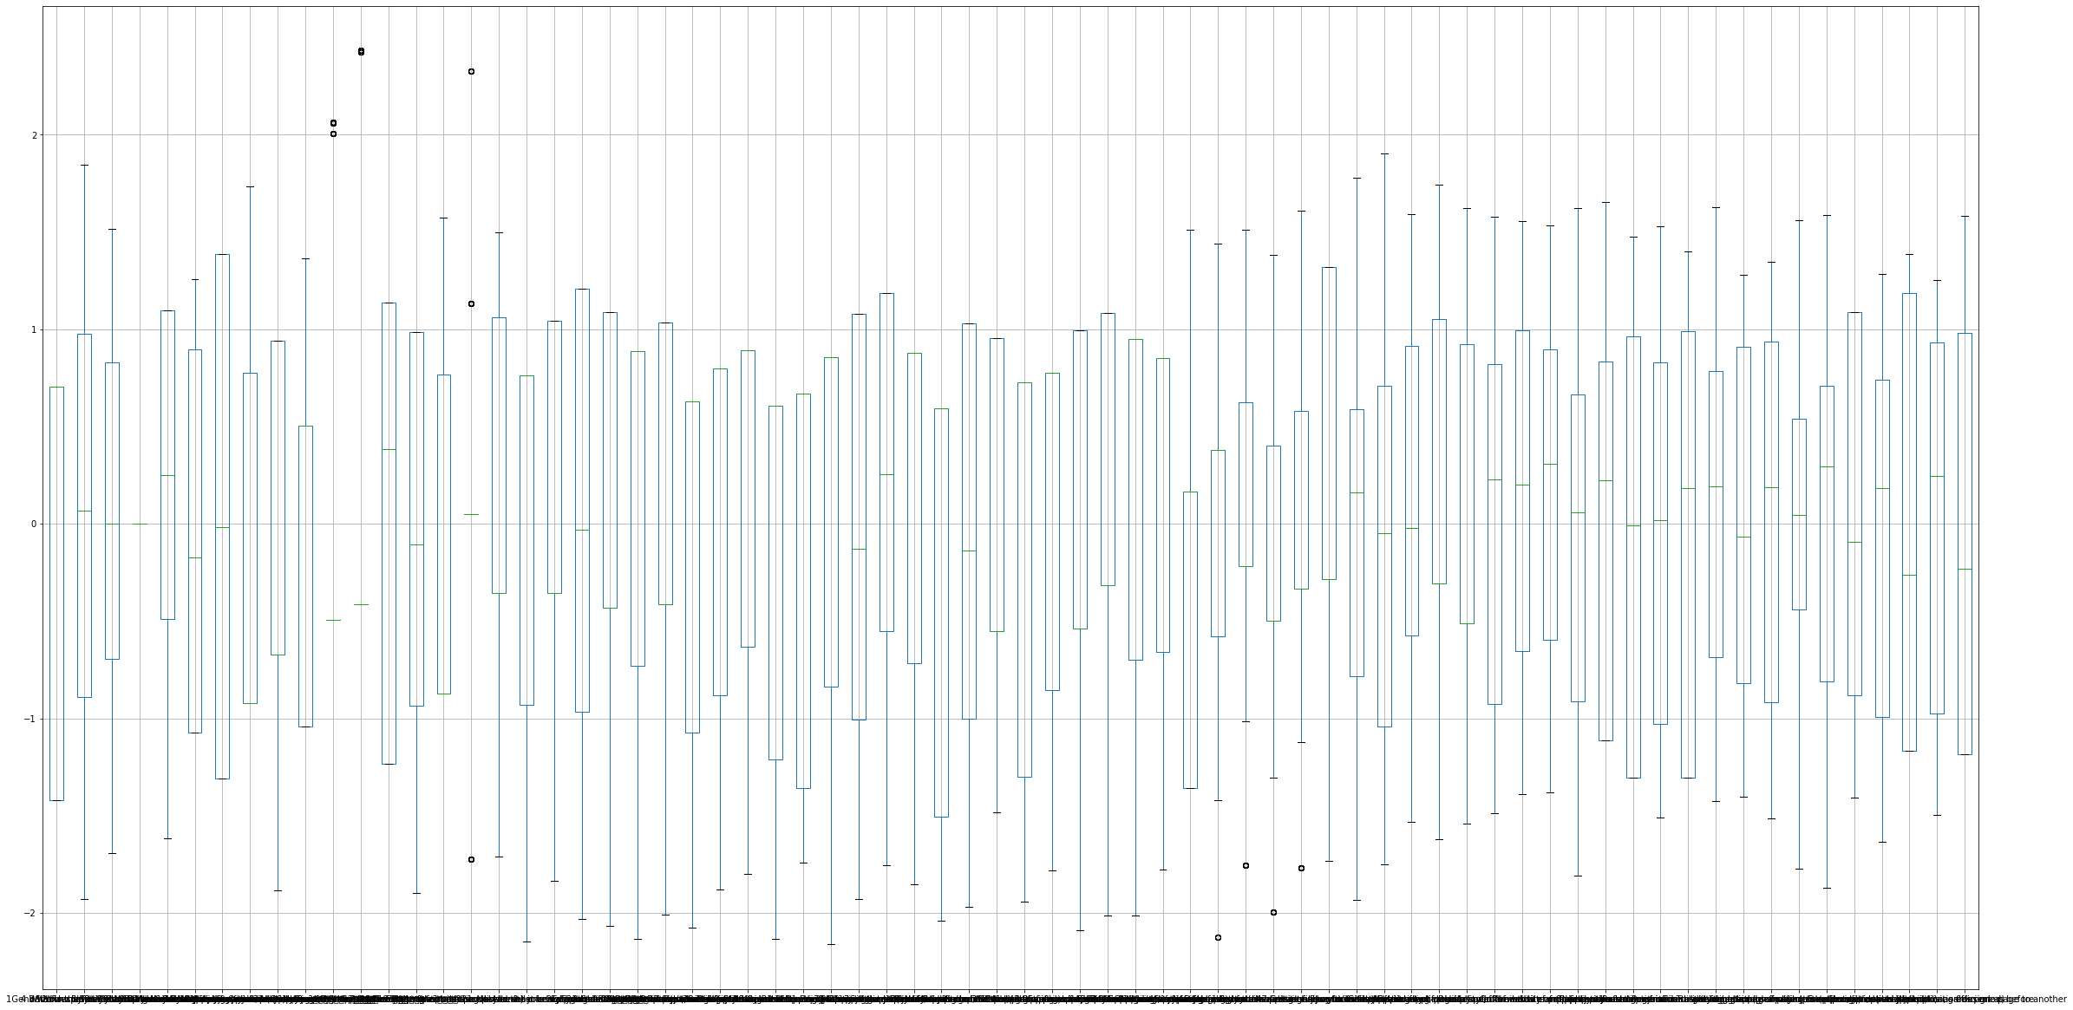

Slide 15
After checking the outliers I did the Train Test Split and find the best accuracy & random state :- The result shown is Best accuracy is 1.0 on Random_state 0
Then perform the model building and I tried to use best possible model building techniques :
- Logistic Regression model :- The Accuracy is 100.0
- Decision Tree Classifier :- The Accuracy is 100.0
- Random Forest Classifier :- The Accuracy is 100.0
- SVC (Support Vector Classifier) :- The Accuracy is 100.0
Next I did Cross Validation for all the models I used & it shows the output :
- Cross Validation Score Of Logistic Regression Model : 1.0
- Cross Validation Score Of Decision Tree Model : 1.0
- Cross Validation Score Of Random Forest Model : 1.0
- Cross Validation Score Of SVC Model : 1.0

Slide 16
Then with the Hyperparameter Optimization Technique 'GridSearchCV' fit the data in model​ :- The result is Grid Search CV 1.0
​Finally, plotted the ROC AUC Curve for the output​

Slide 17
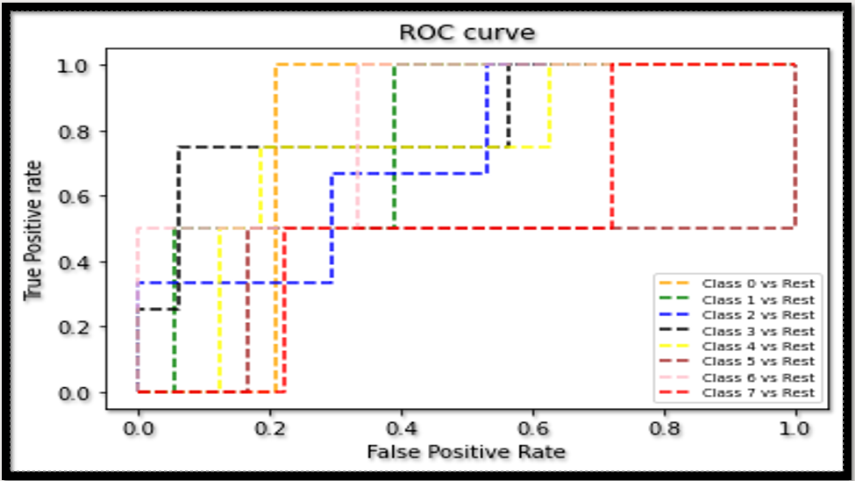

Slide 18
CONCLUSION​
Conclusion as per the results found those are all the models have same result for the dataset with 100% accuracy.
The final accuracy with GridSearchCV is 100%

Slide 19
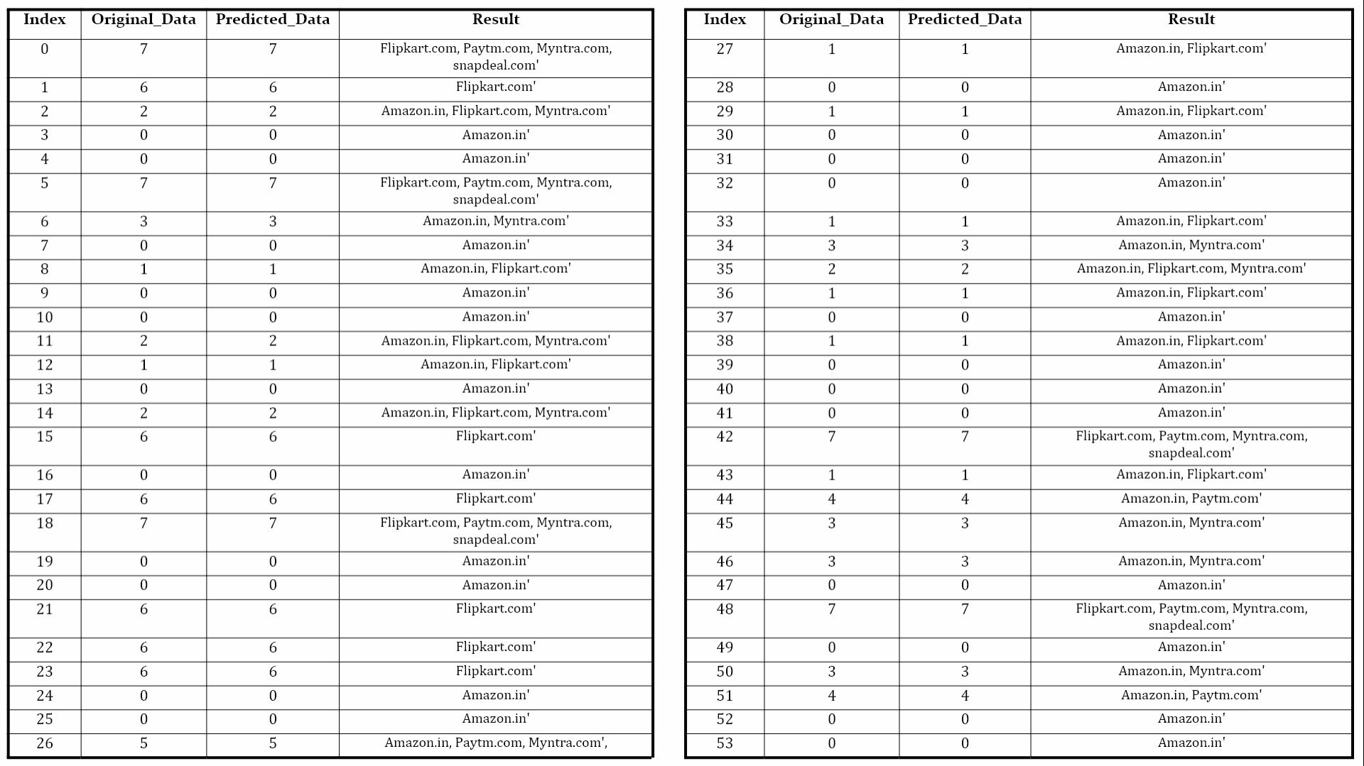

Slide 20
LINKS FOR REFERENCE
Correlation Matrix -
https://github.com/komalghatvilkar/Internship/blob/main/Customer_Retention_Case_Study%20-%20Assignment%204/Customer%20Retention-Correlation%20Matrix.png
Visualization : Histogram -
https://github.com/komalghatvilkar/Internship/blob/main/Customer_Retention_Case_Study%20-%20Assignment%204/Customer%20Retention-Histogram.png
Outliers : Boxplot -
https://github.com/komalghatvilkar/Internship/blob/main/Customer_Retention_Case_Study%20-%20Assignment%204/Customer%20Retention-%20Outliers%20In%20Data.png
ROC Curve -
https://github.com/komalghatvilkar/Internship/blob/main/Customer_Retention_Case_Study%20-%20Assignment%204/Customer%20Retention-ROC%20Curve%20of%20Dataset.png​
Conclusion -
https://github.com/komalghatvilkar/Internship/blob/main/Customer_Retention_Case_Study%20-%20Assignment%204/Conclusion%20Data.JPG

Slide 21

Thank You....!!!

